Slide 1
Circular Flow in a Three-sector Economy

Slide 2
Circular Flow in a Three-sector Economy
The government also plays a crucial role in the economic development of a country. Therefore, the circular flow of income in a three-sector economy includes households, firms, and the government sector. The government of a country acts as both a firm and a consumer. As a firm or producer, the government produces goods and services for the economy. However, as a consumer, it spends money on the consumption of goods and services produced by the firms. Besides the flows of circular income in the two-sector economy with a financial market, the additional flows due to the inclusion of the Government are:

Slide 3
1. Between Households and Government:
The money from the government to households flows in an economy in two forms. First, in the form of transfer payments, such as old age pensions, scholarships, etc. Second, in the form of factor payments for hiring factor services of the households. This money flows back from households to the government in the form of direct taxes, such as interest tax, income tax, etc.

Slide 4
2. Between Firms and Government:
The money from firms to the government flows in an economy in the form of direct and indirect taxes. However, the money from the government to the firms flows into an economy in the form of subsidies. In this case, the government grants subsidies to the firms and makes payments to the firms for the purchase of goods and services produced by them.
The financial market also plays an important role in a three-sector economy, as the government saves a part of their earned income and deposits the same in the financial market. Besides, the government also borrows money from the financial market so it can meet its expenditures.

Slide 5
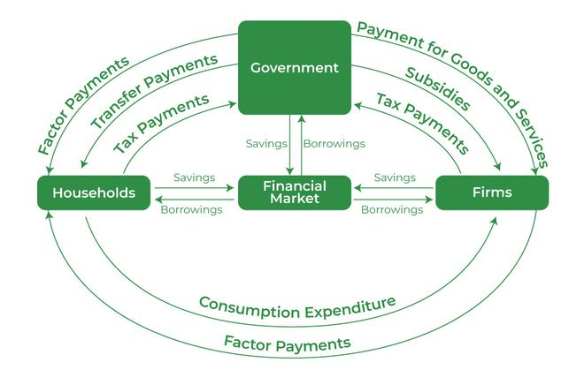
This concept can be better understood with the help of the following diagram:

